Slide 1

DECISION SUPPORT SYSTEM
FOR CUSTOMER RELATIONSHIP MANAGEMENT

Slide 2
Outline
Problem
Specific Requirement
System design
Algorithm & Conclusion

Slide 3
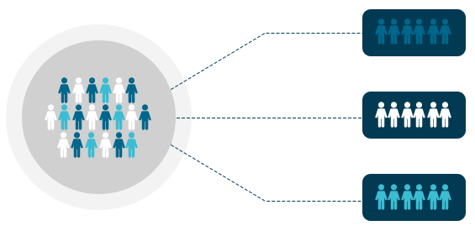
Problems
Nowadays, businesses have thousands, even millions of customer data with different characteristics and behaviors. This makes applying a traditional marketing strategy challenging and ineffective. Therefore, a decision support system is needed to segment customers, in order to:
Focus resources and marketing efforts on specific customer segments
Create tailored marketing campaigns that suit the needs and preferences of each customer segment
Notes:
Nowadays, businesses have thousands, even millions of customer data with different characteristics and behaviors. This makes applying a traditional marketing strategy challenging and ineffective. Therefore, a decision support system is needed to segment customers, in order to:
Focus resources and marketing efforts on specific customer segments, increasing conversion rates and improving marketing performance.
Create tailored marketing campaigns that suit the needs and preferences of each customer segment, increasing satisfaction and loyalty to the brand.

Slide 4
Specific Requirement
Functional Requirement
Customer Clustering
Displaying the characteristics of each cluster
Non Functional Requirement
User-friendly interface, easy to use
Data update at least once a day
Able to serve 10 simultaneous users
Notes:
For functional requirement, this system canbe:
- Customer clustering: The number of clusters depends on the manager's choice
- Displaying the characteristics of clusters enables managers to recognize and comprehend different customer groups
With non functional requirement:
-Our system a user-friendly interface, designed with ease of use in mind.
-To keep data up-to-date, The system (ˌɡerənˈtē)guarantees that data is refreshed at least once every day
-Furthermore, our system is built to handle a significant number of users concurrently. With the ability to serve up to 10 (sai mâu tê ni ợtt) simultaneous users

Slide 5
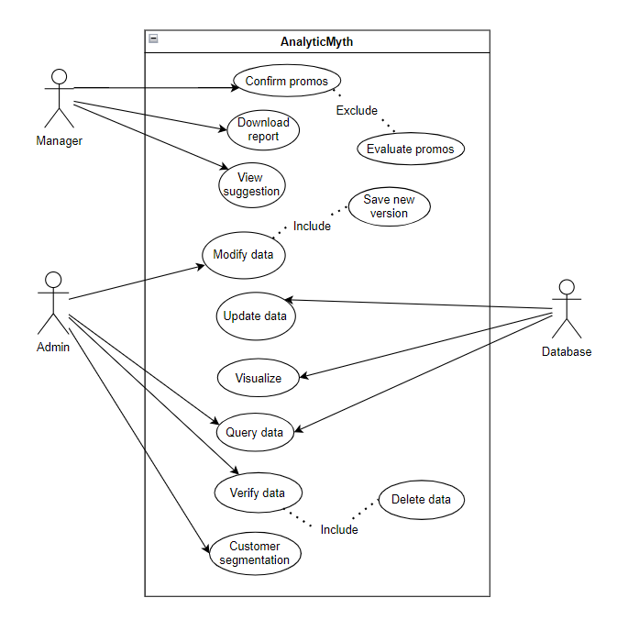
Use-case
Notes:
The use case section includes actor manager, database, admin where manager performs functions such as log in view report, export report, view report analytics. Where database admin performs are log in, update data, modify data

Slide 6
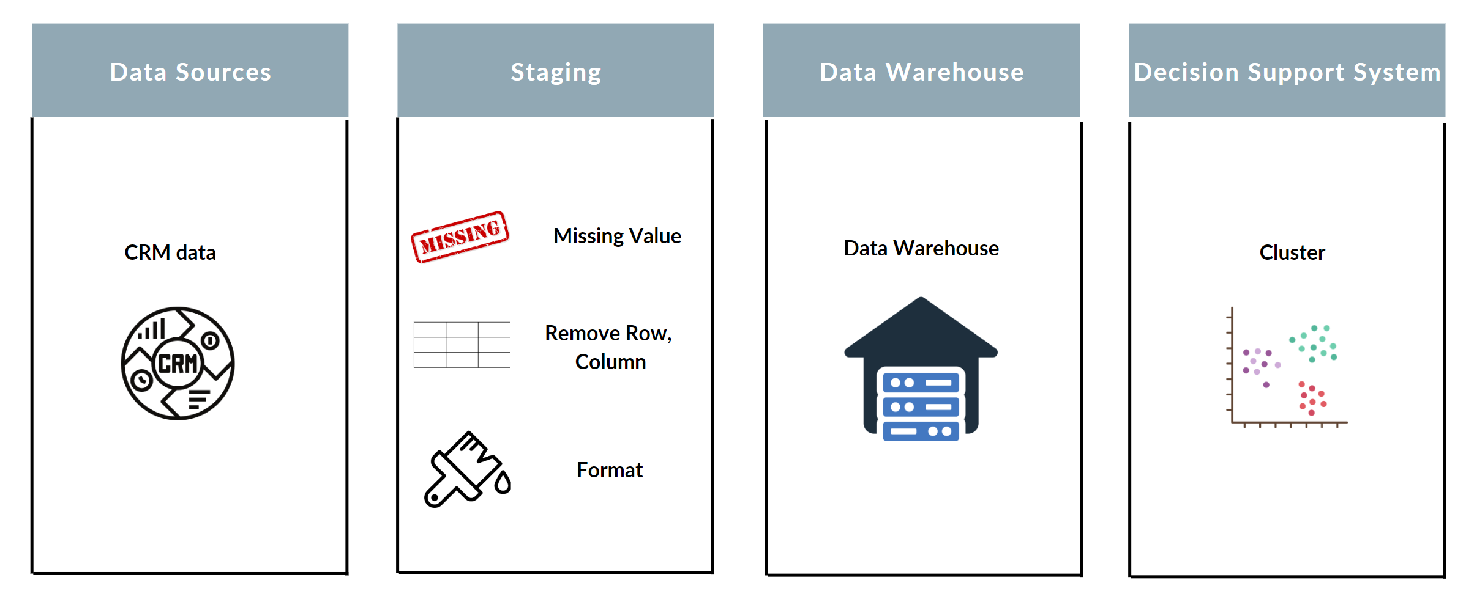
Data Warehouse Architecture
Notes:
My data warehouse architecture consists of four layers. The first layer is Data Sources, which comprises raw data collected from the CRM system,. Next, the data will be processed in Staging to handle missing values, remove unnecessary rows and columns, and format the data. After that, the data will be loaded into the Data Warehouse, and from there, it will be further utilized by the decision support system to perform customer clustering.

Slide 7
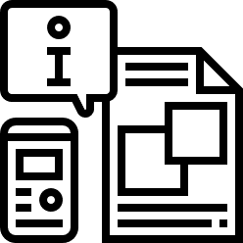
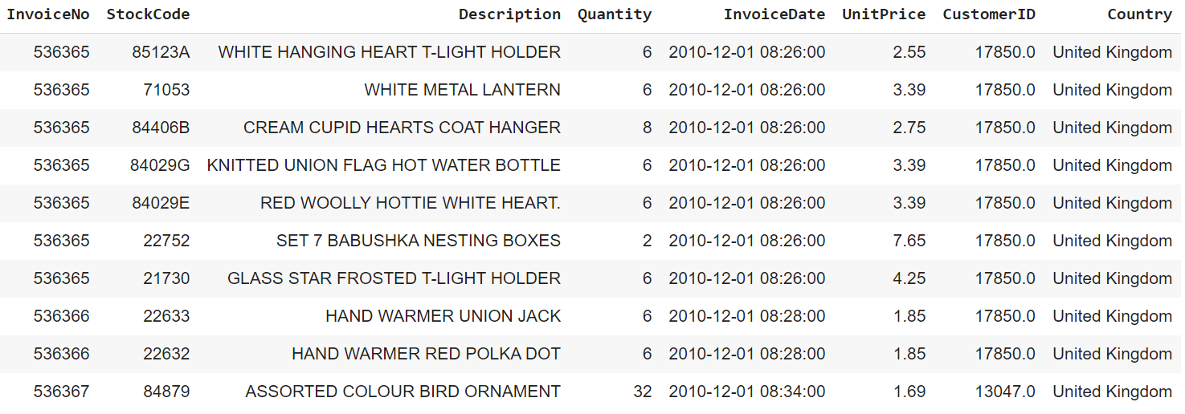
Dataset
The dataset consists of customer information from a retail company recorded over a two-year period.
Notes:
For dataset I use in this system. The dataset consists of customer information from a retail company recorded over a two-year period. This data set include 8 attributes and over Five hundred thousand records

Slide 8
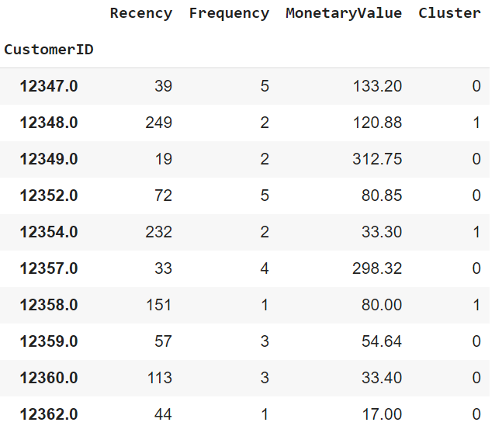
Dataset
Notes:
For dataset I use in this system. The dataset consists of customer information from a retail company recorded over a two-year period. This data set include 8 attributes and over Five hundred thousand records

Slide 9
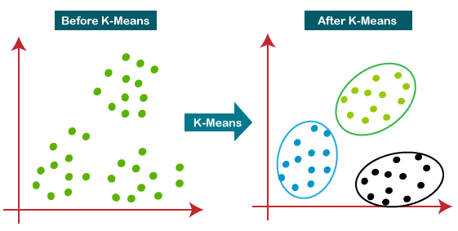
Algorithm
Notes:
In this system, we use the K-means algorithm to cluster customers. The K-means algorithm is an unsupervised data clustering method that groups data points into different clusters based on their similarity in terms of distance.

Slide 10
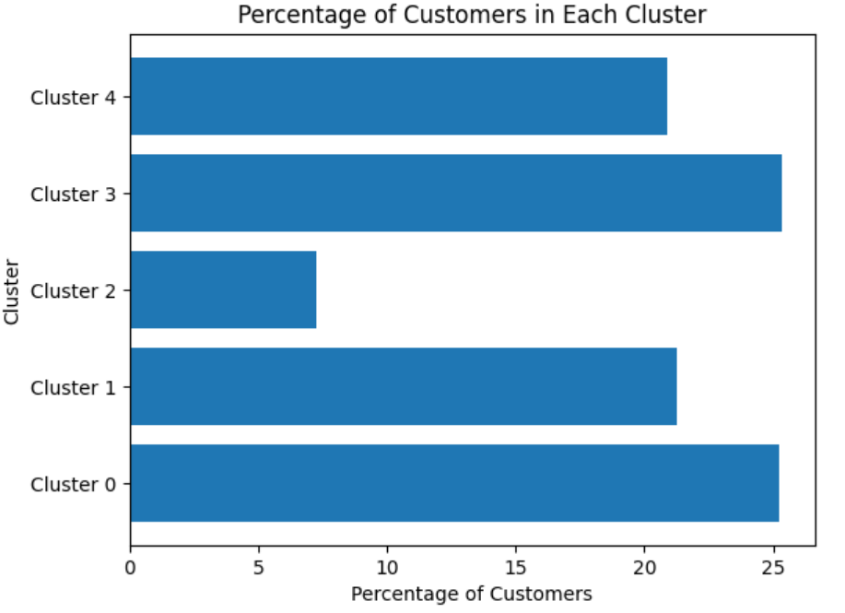
In RFM analysis to provide marketing activities and messages, the number of clusters is decided by the manager, and usually customers are divided into 5 clusters.
The chart above shows the number of customers in each cluster compared to the total number of customers
Notes:
In RFM analysis to provide marketing activities and messages, the number of clusters is decided by the manager, and usually customers are divided into 5 clusters. Therefore in this algorithm I also divide into 5 clusters, and of course the number of clusters can be changed at the discretion of the manager.
After using Kmeans for clustering. The chart above shows the number of customers in each cluster compared to the total number of customers

Slide 11
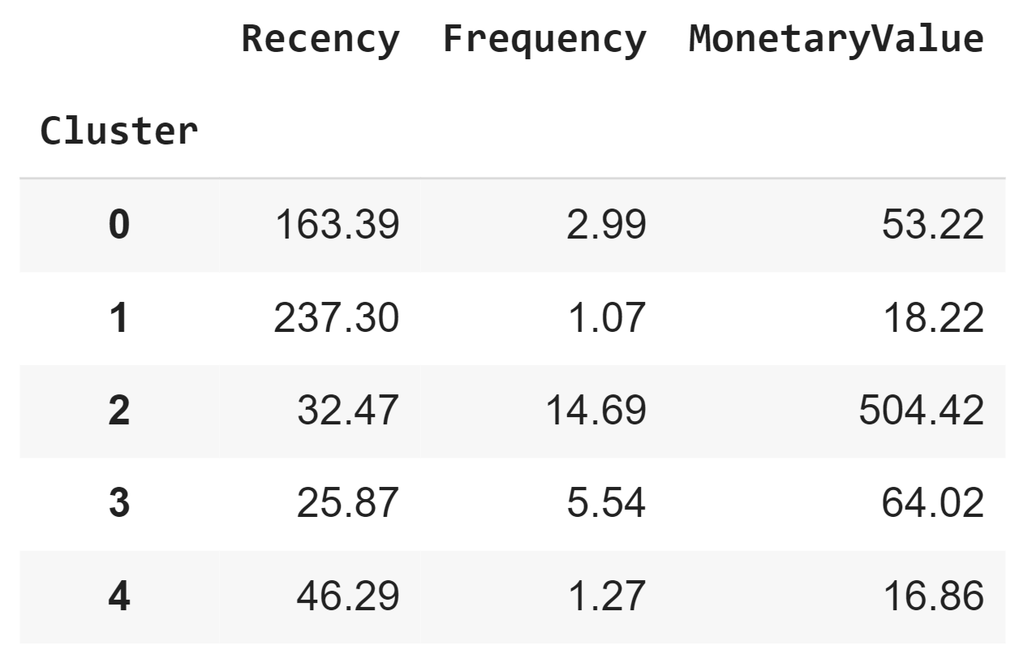
Notes:
Next, the above table shows the mean values of the attributes for each cluster

Slide 12
Conclusion
Cluster 0: Needing Attention, At Risk
Long time no return, used to make frequent purchases, shopping cart value at a reasonable level
Cluster 1: About to Sleep, Hibernating, Lost
Haven't come back for a long time, weak purchasing power
Cluster 2: Champions
Recently purchased, make frequent purchases, and spend a lot of money
Cluster 3: Loyal, Potential Loyalist
Recently purchased, make frequent purchases, shopping cart value at a average level
Cluster 4: Recent, Promising
Recently purchased, make infrequent purchases, in the experiential phase
Notes:
From that, we reach the following conclusions
Cluster 0: This cluster consists of

Slide 13

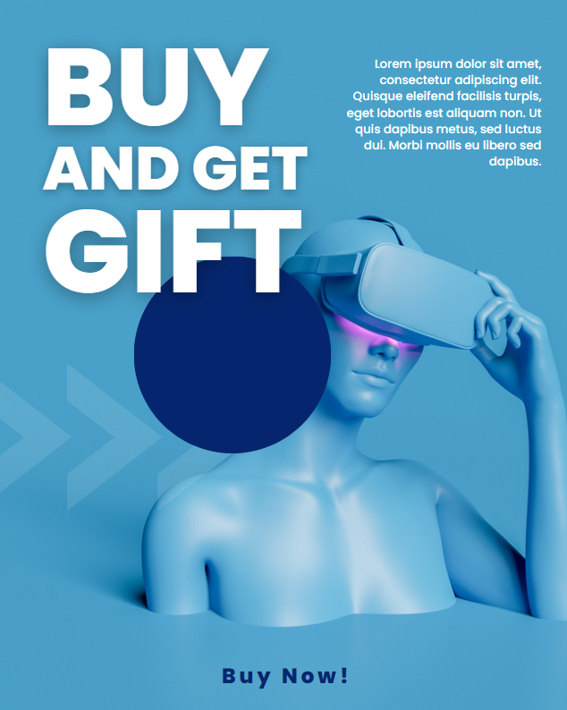
Suggestion
Cluster 0: Needing Attention, At Risk
CRM Strategy: Take a survey to find out what led to their decision not to keep coming back
Cluster 1: About to Sleep, Hibernating, Lost
CRM Strategy: Implement short-term promotions via email such as discounts, gifts
Notes:
Cluster 0:
The business needs to conduct surveys to find out why customers do not return for repeat purchases and suggest improvements instead of relying on extensive discount and promotion programs to avoid budget wastage.
Cluster 1: These customers are usually not easy to re-engage. The business can implement short-term promotions via email, such as discounts or gifts, to try to win them back.

Slide 14
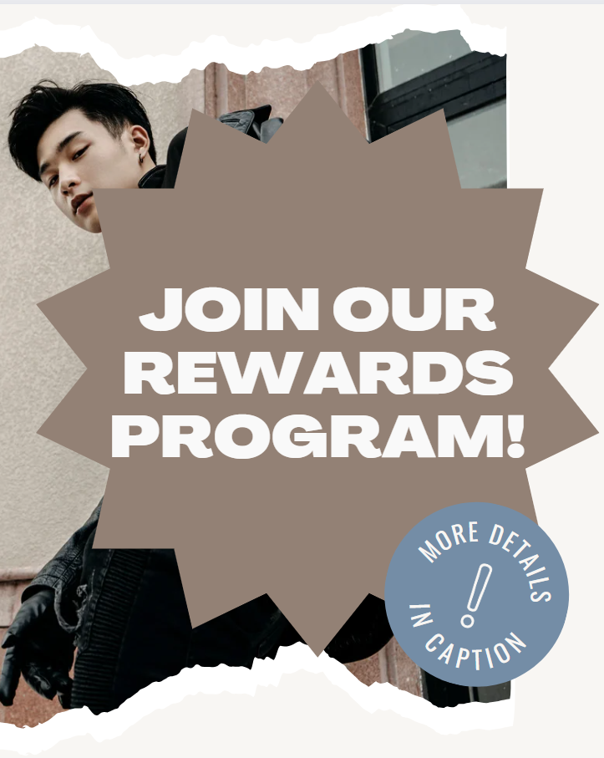

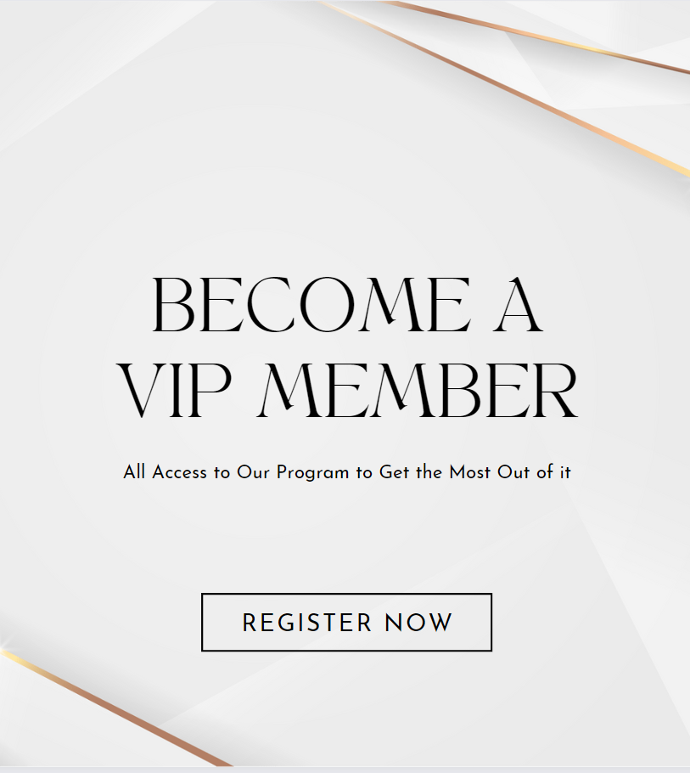
Suggestion
Cluster 2: Champions
CRM Strategy: Propose a key customer program with differentiated and highly personalized values
Notes:
Cluster 2: Champions
This customer group already has a high level of trust and commitment to the brand; the business doesn't need to attract them through discount promotions. Instead, the business can encourage these customers to return more frequently by offering a vip member program.

Slide 15

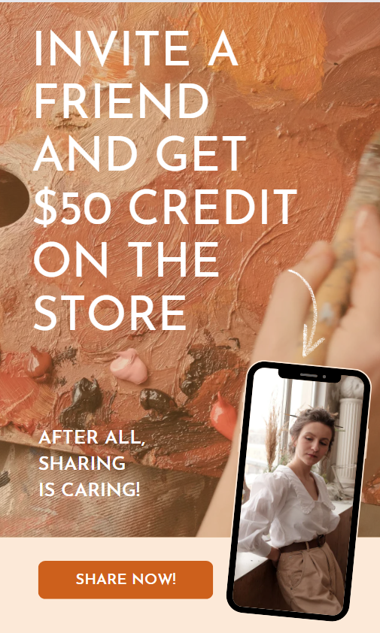
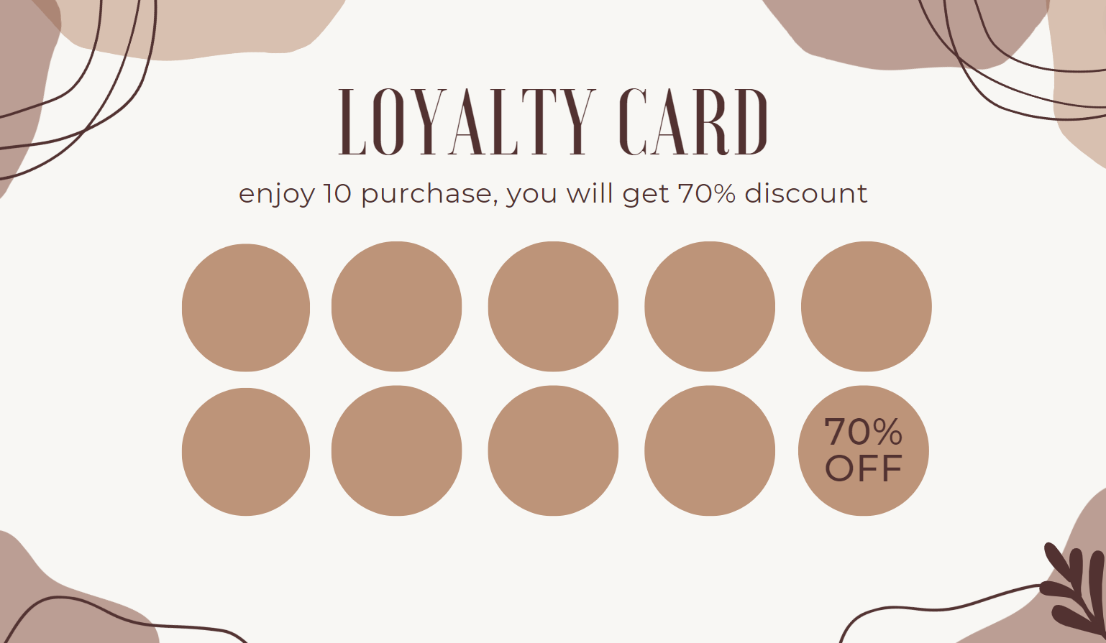
Suggestion
Cluster 3: Loyal, Potential Loyalist
CRM Strategy: Proposing equivalent promotional programs based on customer spending thresholds
Notes:
Cluster 3: Loyal, Potential Loyalist
The business can Proposing equivalent promotional programs based on customer spending thresholds. Referral programs can also be effective ways to attract these customers.

Slide 16
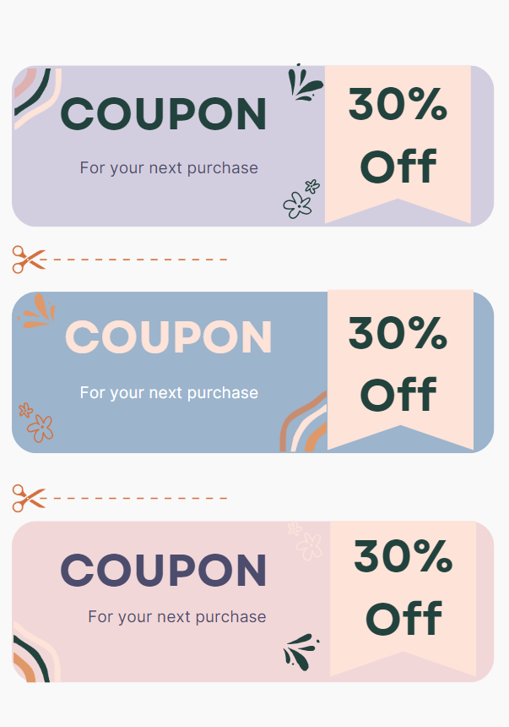
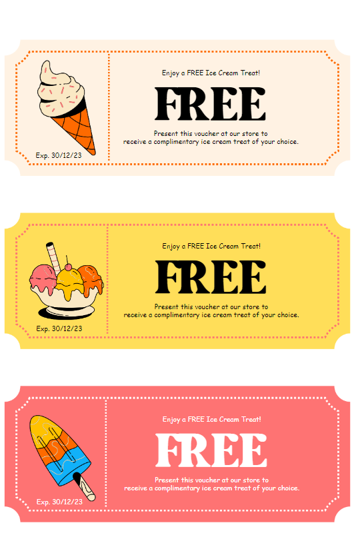
Cluster 4: Recent, Promising
CRM Strategy: Get a discount welcome voucher for next purchase
Notes:
Cluster 4: Recent, Promising Customer These are the customers who have recently made a purchase but have not been frequent buyers yet and are still in the experience and evaluation phase. The business can show appreciation and gather feedback on their shopping experience from the customer's first order, while also offering a welcome discount voucher or free gift for their next purchases.

Slide 17
THANK YOU !

